Slide 1
CA Model for Bidirectional Flow in a Corridor
Sofia Tété Nunes
Pjotr Piet
Maan Scipio

Slide 2
Contents
Goal and Motivation
Hypothesis
Model
Results
Conclusion
References

Slide 3
Goal and Motivation
Practical Applications
Urban planning
Evacuation processes
Busy crowded areas (e.g. concerts)
Crowd behaviour
Lane formation
Congestion
Notes:
Our project is about a CA model for bidirectional flow of pedestrians in a corridor. This situation can be seen in many real life scenarios such as (read practical applications). For this cellular automata model, the main behaviours we were expecting to find were lane formation and congestion.

Slide 4
Research Questions
What is the optimal pedestrian density at which lane formation emerges in the floor field automaton model?
What is the influence of a horizontal bias on lane formation?
What is the critical density for congestion?
What is the influence of corridor height and width on lane formation? (In Appendix)
Notes:
More specifically, for this project

Slide 5

Model: Bidirectional Flow in an Infinite Corridor
Agents that want to exit in the right
Agents that want to exit in the left
Notes:
Explain our problem - say that we have people going to two sides of the INFINITE corridor
Half of the people want to leave through the right exit (orange) and the other half through the left one (blue)

Slide 6
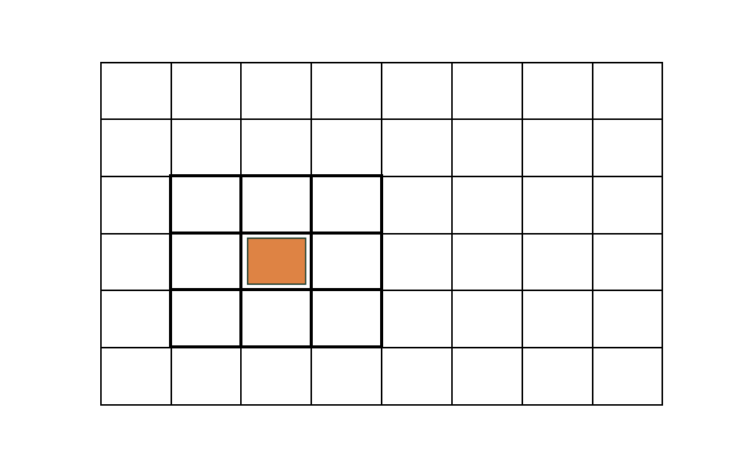
Floor Field Model
2D cellular automata
Moore neighbourhood
a static and dynamic floor field for each agent type
Notes:
Our model is a 2D cellular automata, where a Moore neighbourhood is considered for each agent. Each agent type has a static and a dynamic floor field associated. The static floor field contains the information about the desired direction of movement, while the dynamic floor field is used to model longer ranged interactions
The movement of all agents is defined by update rules that transfer the system from one timestep to the next. these update rules are defined by the probability of moving from one cells to any other of the neighbours cells

Slide 7
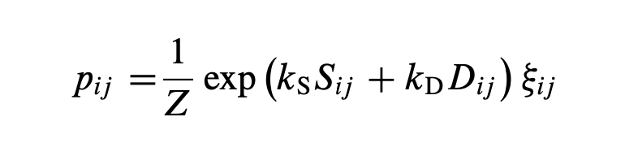
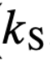
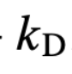
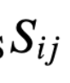
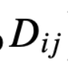
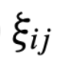

Floor Field Cellular Automaton
static field coupling constant
dynamic field coupling constant
static field
dynamic field
factor which is 0 for occupied cells and 1 for unoccupied ones
normalization factor

Slide 8
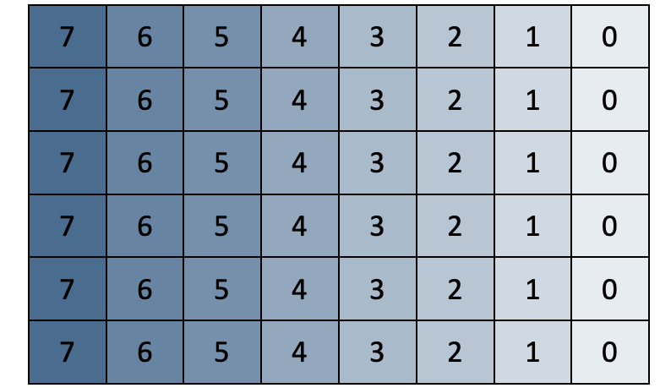
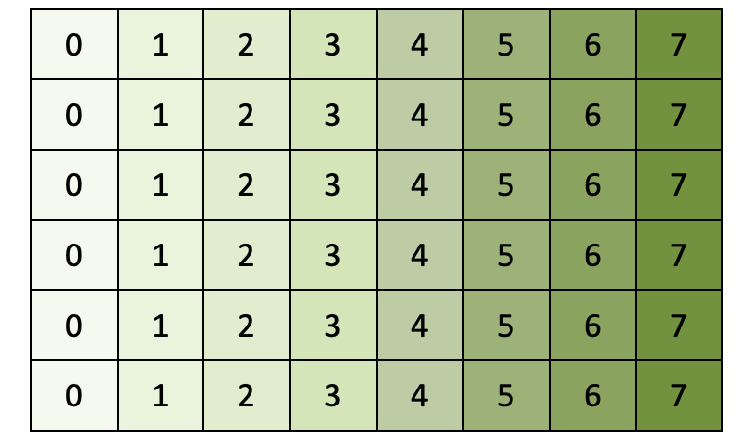
Static Floor Fields
Static Floor Field 1
Agents move from the left to the right
Static Floor Field 2
Agents move from the right to the left
Notes:
Pjotr begin

Slide 9
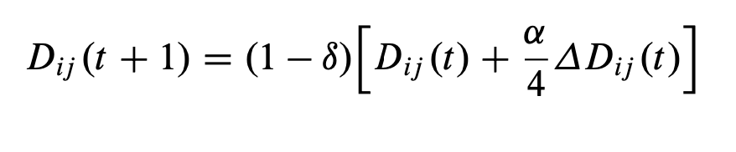
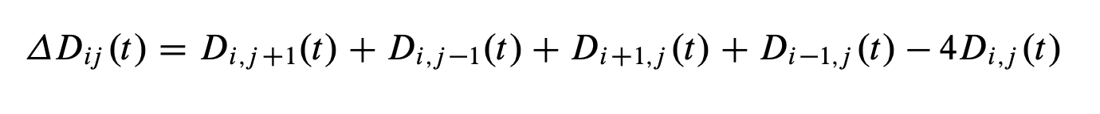
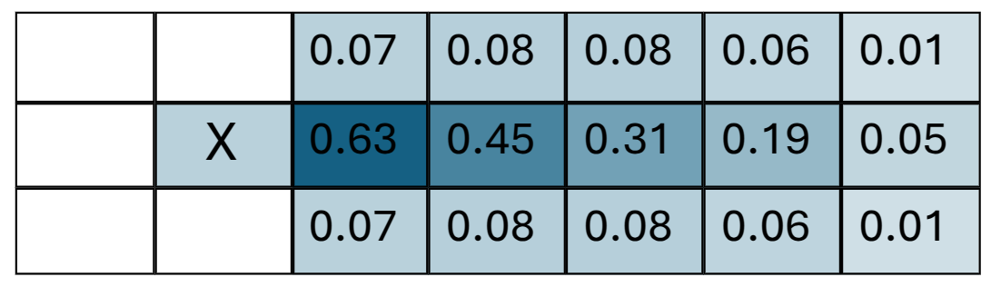
Dynamic Floor Fields
The dynamic floor field is a virtual layer that records movement, where particles leave temporary traces that attract others to follow the same path. The value for each cell is obtained with:
Where,

Slide 10
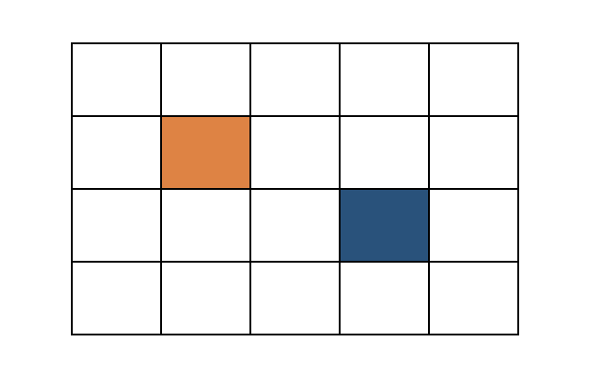
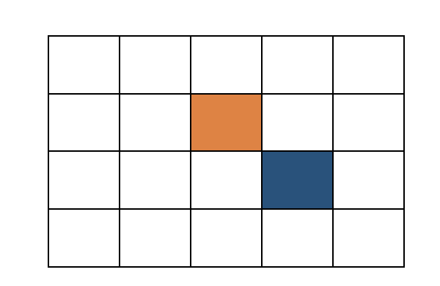
Conflicts
If there is a conflict, there is a μ probability that it is not solved and both agents stay in the same place
And a probability 1- μ that the conflict is solved and one agent is randomly chosen to move to the new position

Slide 11
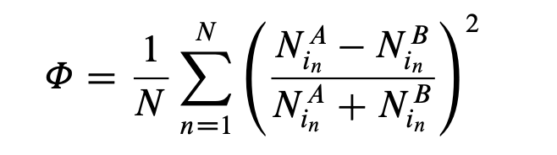
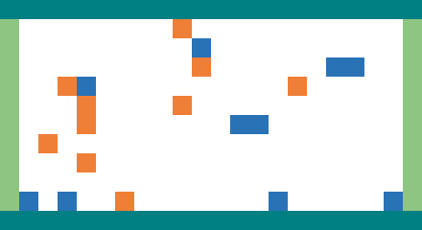
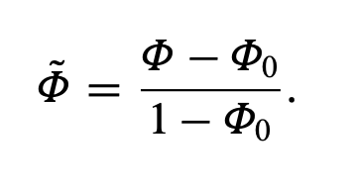
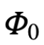
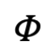
Order Parameter for Lane Formation
In order to quantify the lane structure in the system, we use an order parameter given by:
For our simulations we use the reduced order parameter:
where is the mean value of for the case where all particles are distributed at random.
Notes:
This order parameter looks at each row and determines the amount of agents of each type in each row. If these values Na and Nb are similar, the order parameter will be close to zero. If Na and Nb differ a lot, meaning that the row is dominated by one type of agent, the order parameter will be high.

Slide 12
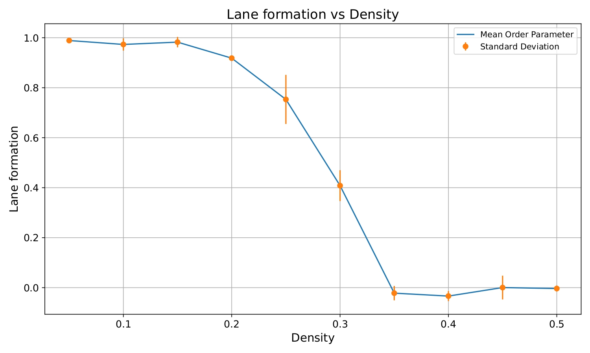
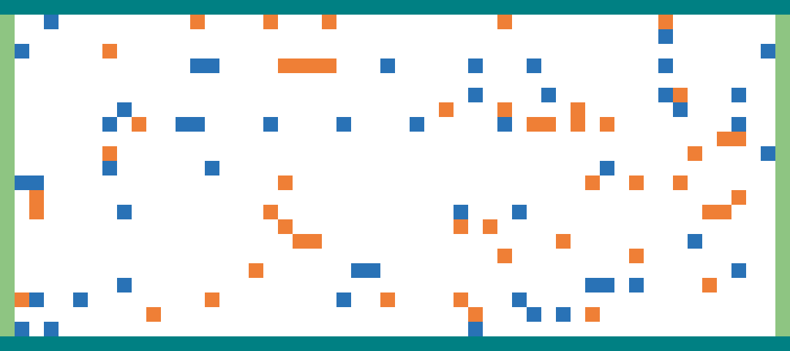
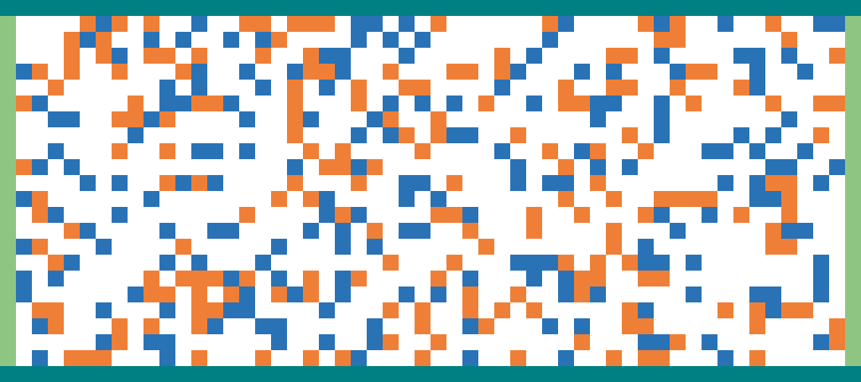
Influence of Density on Lane Formation
Density of 0.1:
Density of 0.4:
Notes:
In some parts of the graph the lane formation/order parameter dips below zero. This is because then the model performs worse than for the random initial case with which phi has been normalized.

Slide 13
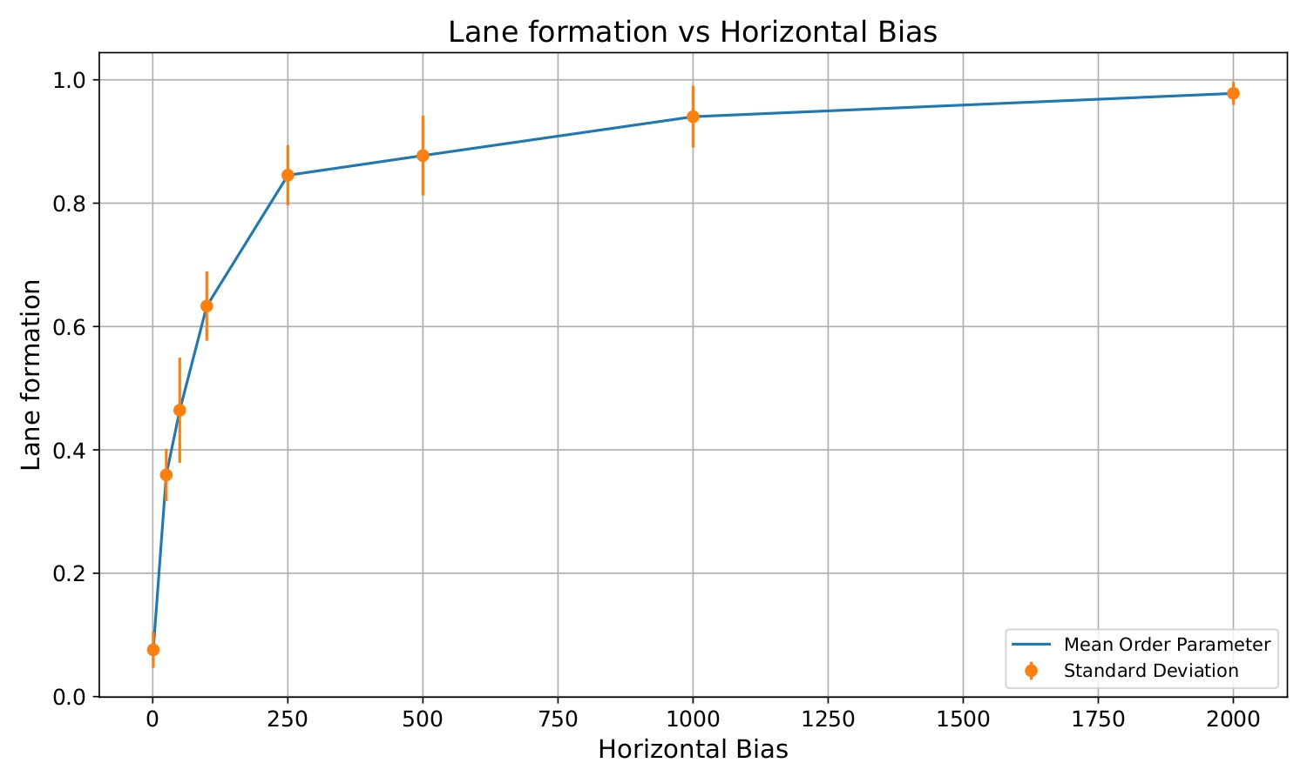
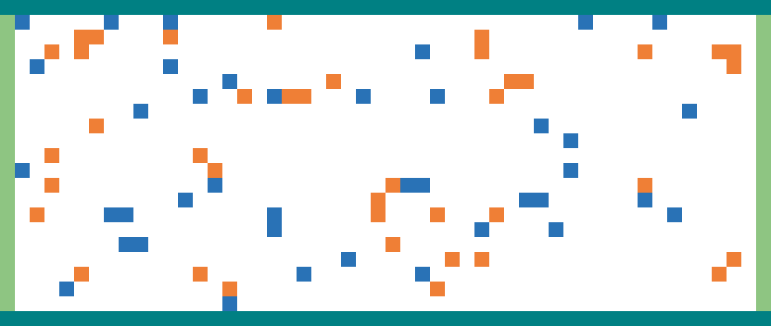
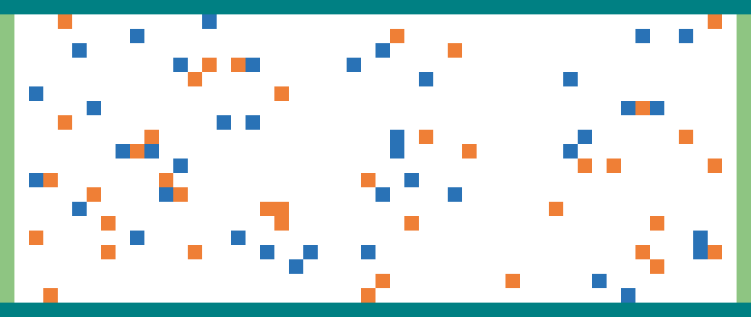
Horizontal Bias Parameter
horizontal bias=1
horizontal bias=2000
Notes:
explain bias :) (pjotr eind) and maybe add some nice gifs as well

Slide 14
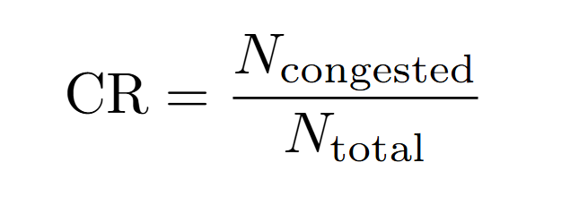
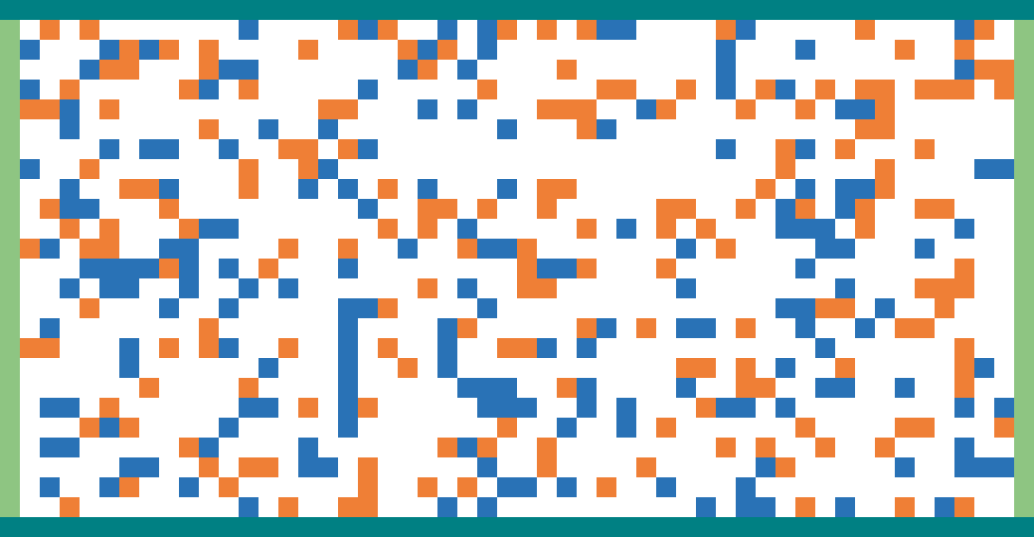
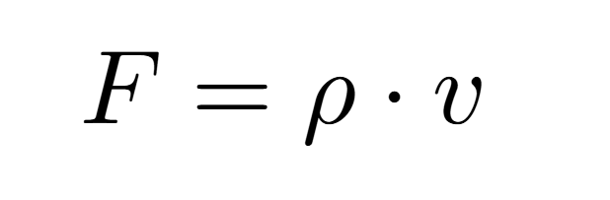
Metric for Congestion
Congestion Ratio:
Agent Flux:
Notes:
-Here F is the agent flux. Rho is the density of particles and v the average velocity of the particles. The congestion ratio is determined by dividing the number of congested agents by the total number of agents. Amongst congested agents we take all agents that have not moved forward.
-on the right side there is a gif of the congestion. You can see some percolating particles

Slide 15
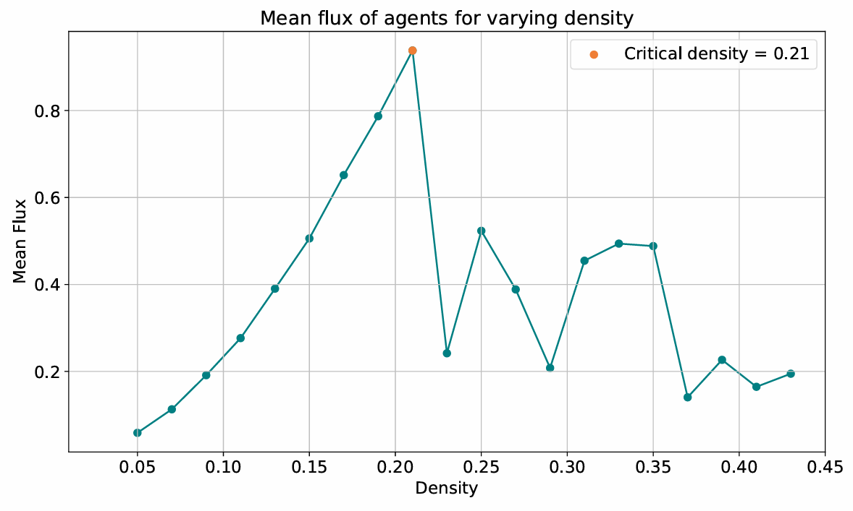
Critical density for Congestion
Notes:
On the y axis is the total flux as defined in the previous slide, plotted against the density. The critical density is at approximately 0.21

Slide 16
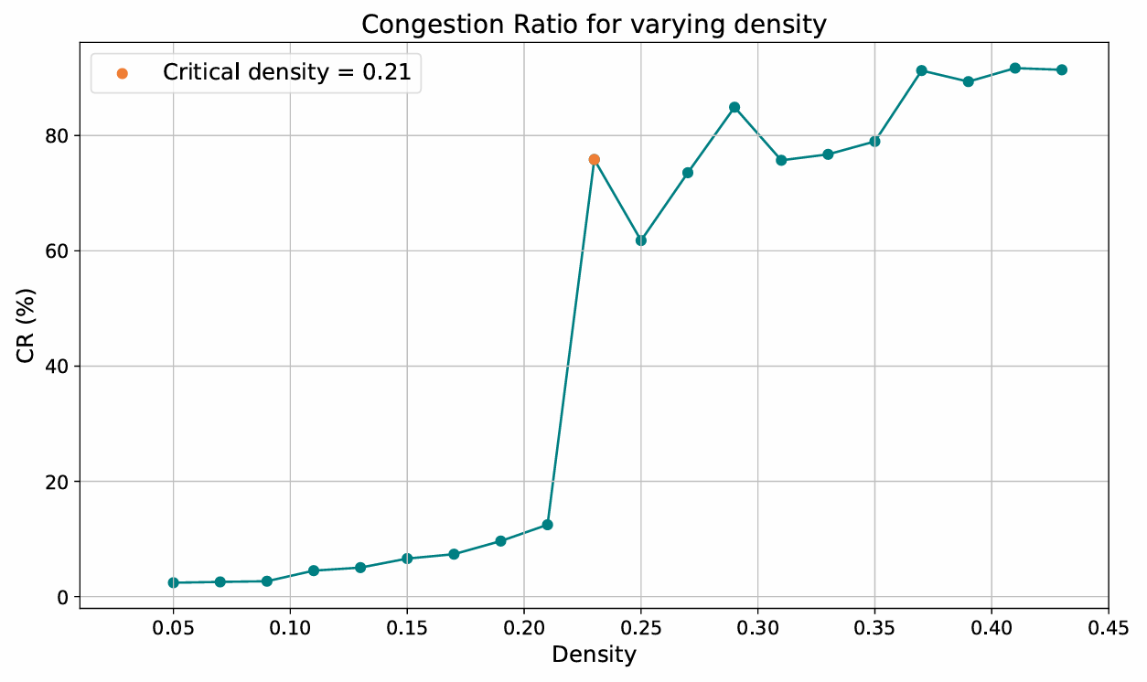
Congestion Ratio

Slide 17
Conclusions
Observed Emergence: Each pedestrian responds to immediate surroundings, leading to global patterns:
Lane Formation (Self-Organization): pedestrians naturally align their movement with others, minimizing interference and optimizing flow.
Congestion (Phase Transition): as pedestrian density increases, movement transitions from a free-flowing state to congestion.
Conclusions:
Lane formation was observed (for lower densities)
Congestion was observed (for higher densities)
A horizontal bias factor increases lane formation
Notes:
Each pedestrian responds to immediate surroundings, leading to global patterns:
Lane Formation (Self-Organization): pedestrians naturally align their movement with others, minimizing interference and optimizing flow. This self-organization emerges from local interactions, where individuals adjust their paths based on nearby movement.
Congestion (Phase Transition): as pedestrian density increases, movement transitions from a free-flowing state to congestion. This phase transition is driven by local interactions, where minor slowdowns propagate.

Slide 18
Future Work
Implement swapping
Looking into how swapping can affect the percolation rate of the congestion
Adding objects
Changing structure (e.g. T-shape)

Slide 19
References
Nowak, S., & Schadschneider, A. (2013). A cellular automaton approach for lane formation in pedestrian counterflow. In Traffic and Granular Flow'11 (pp. 149-160). Springer Berlin Heidelberg
Varas, A., Cornejo, M. D., Mainemer, D., Toledo, B., Rogan, J., Munoz, V., & Valdivia, J. A. (2007). Cellular automaton model for evacuation process with obstacles. Physica A: Statistical Mechanics and its Applications, 382(2), 631-642
Wang, Z., Chen, T., Wang, Y., Li, H.(2024). A cellular automaton model for mixed traffic flow considering the size of CAV platoon. Physica A: Statistical Mechanics and its Applications, 643

Slide 20
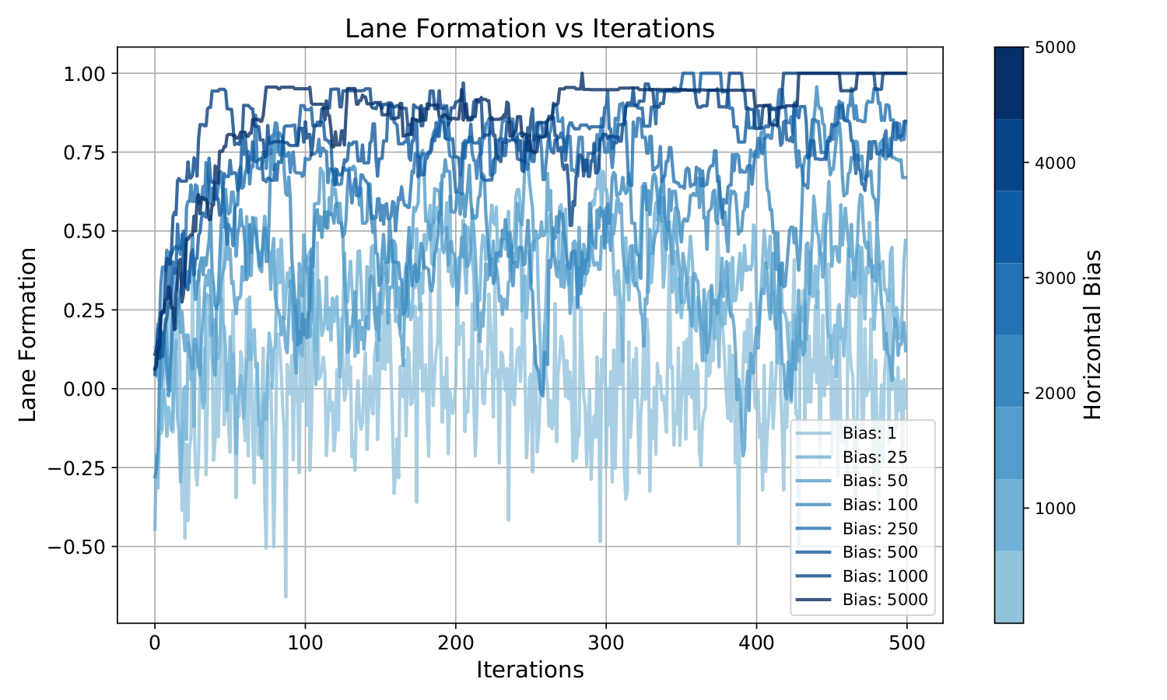
Extra Slides

Slide 21
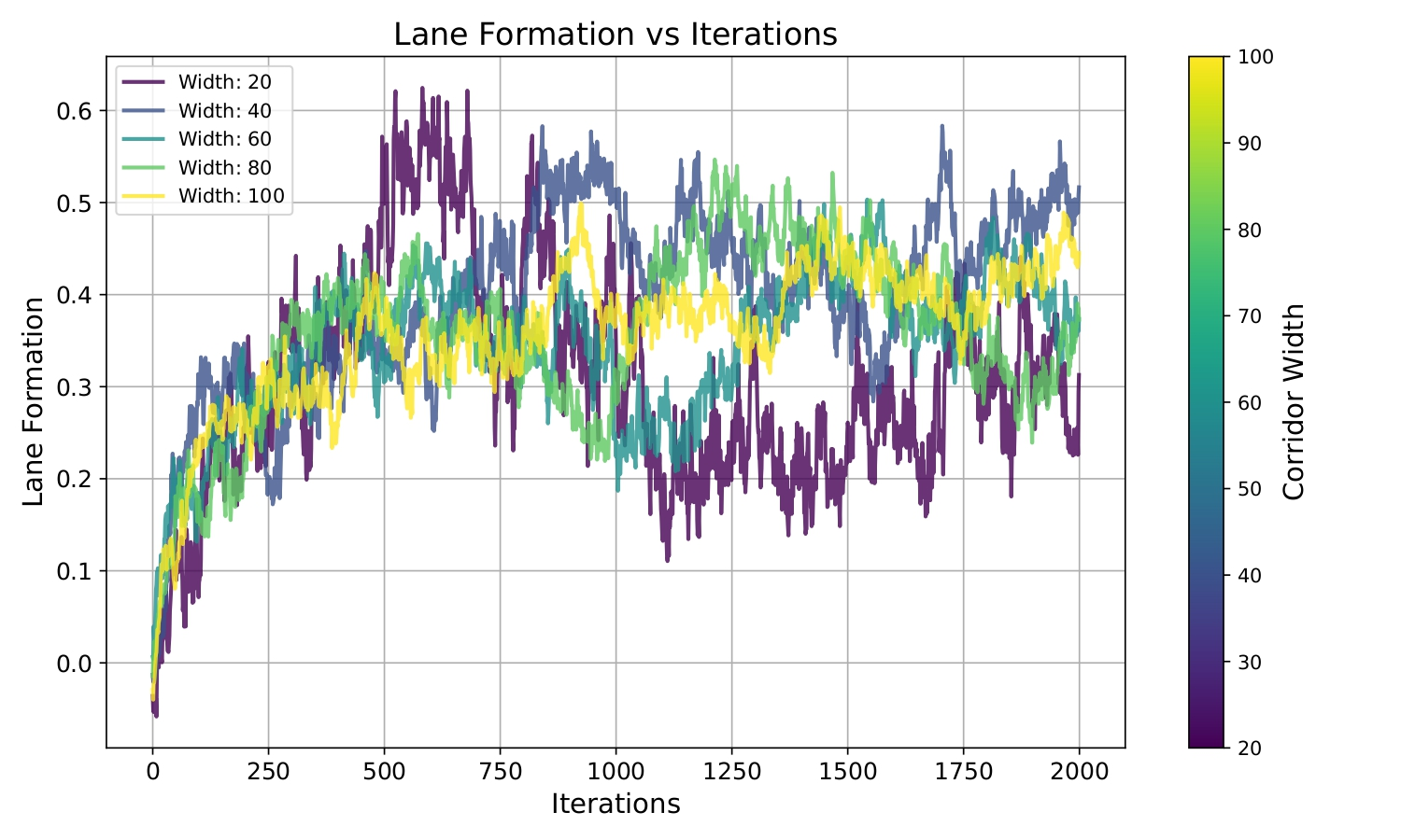
Dependence of Lane Formation on Corridor Width

Slide 22
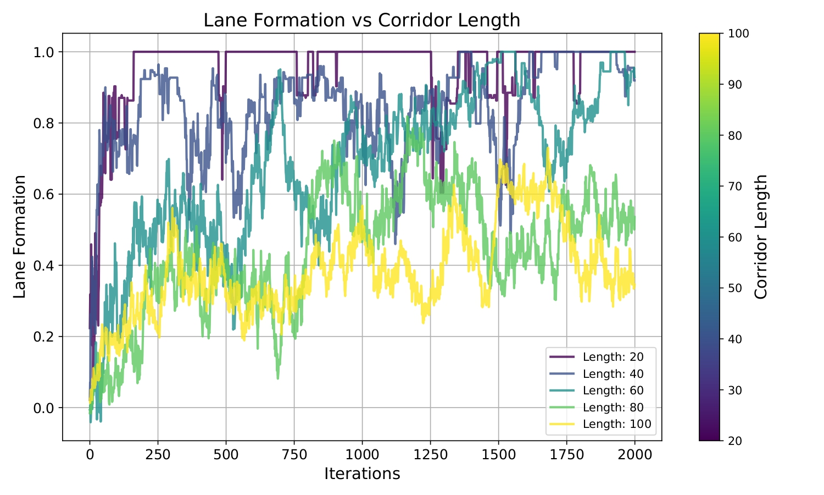
Dependence of Lane Formation on Corridor Length

